Slide 1

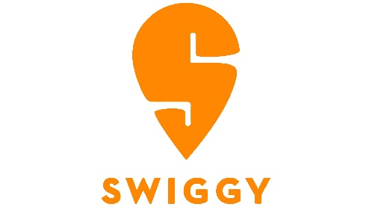
SALES ANALYSIS

Slide 2

OBJECTIVE:
The primary objective of this project is to design and develop an interactive sales dashboard in Microsoft Excel using Swiggy’s order dataset.
The dashboard aims to provide clear insights into:
Sales performance
Restaurant contribution
Cuisine popularity
Customer location preferences
Payment method trends
Order delivery efficiency
This will help management monitor performance, identify growth areas, and support data-driven decision making.

Slide 3

SALES OVERVIEW:
The sales dashboard reflects a total revenue of ₹141,181 generated from 200 orders, with an average order value of ₹856. The sales trend shows steady customer activity with regular fluctuations over time, indicating consistent demand. Most orders were successfully delivered, with 112 deliveries compared to 88 cancellations, showing stable operational performance overall. The data highlights healthy sales levels and strong engagement across different locations
and payment methods.

Slide 4

TOP PERFORMING RESTAURANTS:
The sales data shows that fast-food brands dominate overall performance, with McDonald's leading in total revenue, followed by other strong contributors such as KFC, Burger King, Subway, and Pizza Hut.
These restaurants consistently generate high order volumes due to their widespread popularity and quick-service menus. The trend reflects strong customer preference for fast-food and café-style cuisines, which remain the primary drivers of sales across the platform. Their steady contribution highlights both strong brand loyalty and frequent repeat purchases

Slide 5

LOCATION BASED SALES INSIGHTS:
Sales data shows strong customer activity in Pune, Mumbai, and Hyderabad, which record the highest order volumes and reflect strong demand in these regions. Other major cities such as Delhi, Chennai, Bengaluru, and Ahmedabad also show steady contributions, indicating that sales are well-distributed across multiple urban locations.
This spread highlights a broad customer reach and
consistent engagement across key markets.

